Slide 1



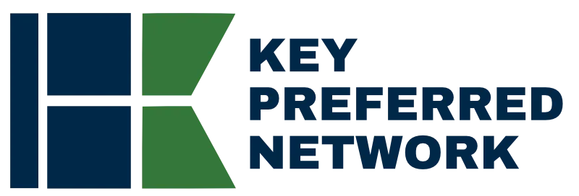
Direct-to-Employer
Go-to-Market Strategy
OPPORTUNITY REVIEW | NOVEMBER 2026
Exploring an OhioHealth direct-to-employer health plan within Ohio's statewide Key Preferred Network
Prepared for
Statewide network

Slide 2



Ohio is ready for a statewide direct-to-employer network
EXECUTIVE SUMMARY
A statewide network is forming
Two ways for OhioHealth to participate
Steerage without restricting choice
KBA is already working with University Hospitals in Northeast Ohio and The Christ Hospital in Southwest Ohio on a statewide plan. OhioHealth completes Central and Southeast Ohio.
Launch an OhioHealth-branded plan built on Key Preferred's broad statewide contracts, or join Key Preferred as the preferred health system for its region.
Key Preferred Benefits reward members for using preferred systems, while the broad network lets them go anywhere. KBA networks average 83% Tier 1 steerage.
$20.6M
Projected Year 4 net margin change for OhioHealth
Target case for an OhioHealth-branded plan: 18,600 members, 67% inpatient and 58% outpatient steerage, 26.4% commercial margin

Slide 3

A national leader in self-funded plans
ABOUT KEY BENEFIT ADMINISTRATORS
1979
3,000+
Founded in Indianapolis
Corporate clients
3M
700
Members under management
Employees
Largest independently owned full-service third-party administrator
Specialists in self-funded plan administration and population health management
A leader in the direct-to-employer movement
Works with every professional team: agents, networks and MGAs
The Key Family of Companies is a vertically integrated group of benefit organizations

Slide 4
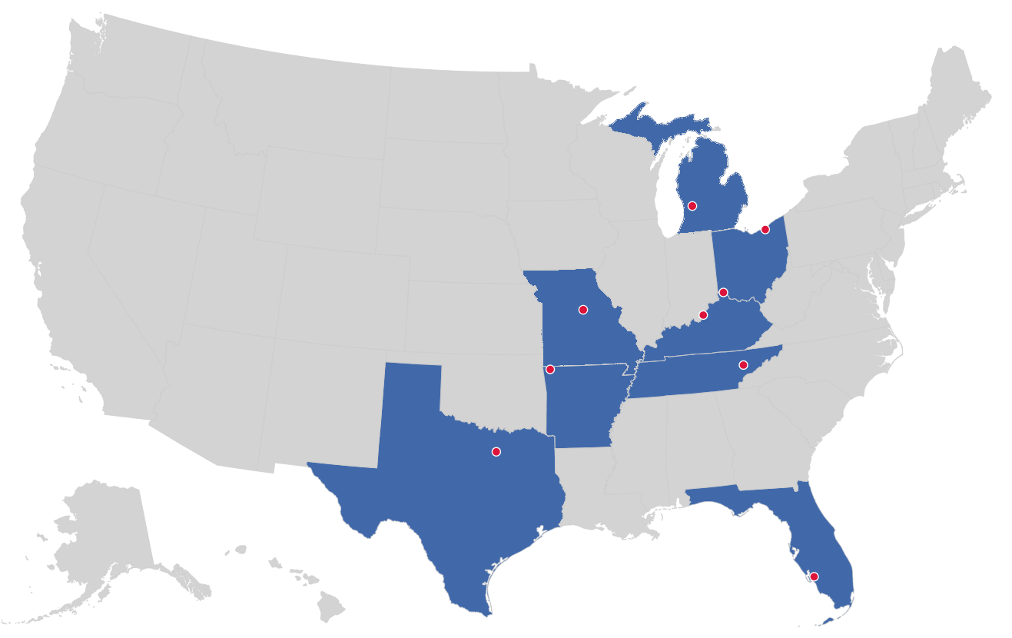


Market leader in private-labeled DTE plans
TRACK RECORD
Private-labeled DTE markets
Cleveland, OH
Cincinnati, OH
Grand Rapids, MI
Columbia, MO
Louisville, KY
Knoxville, TN
Bentonville, AR
Dallas-Fort Worth, TX
Fort Myers, FL
Already active in two Ohio markets

Slide 5
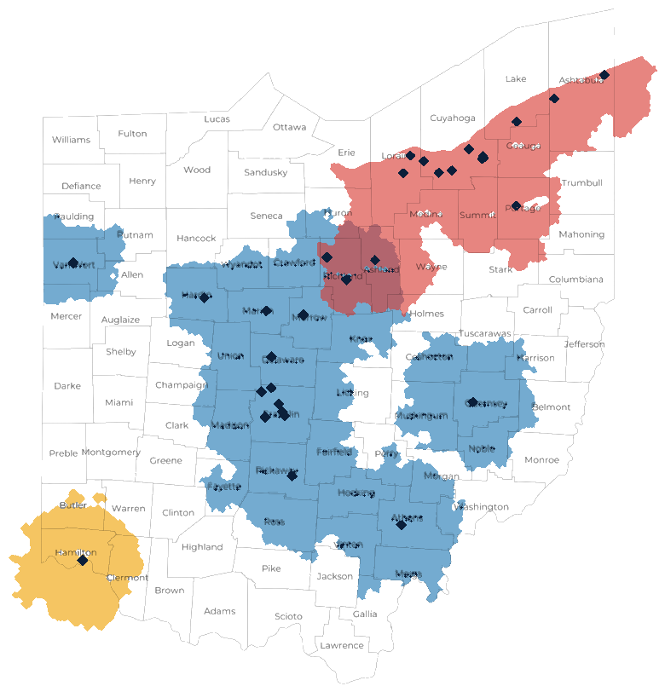


Three anchor systems, three largest Ohio metros
OHIO STATEWIDE STRATEGY
WORKING WITH KBA TODAY
Northeast Ohio: Cleveland, Akron and the Lake Erie corridor to Ashtabula
THE OPPORTUNITY
Central and Southeast Ohio: Columbus, Mansfield, Marion, Athens, Cambridge and Van Wert
WORKING WITH KBA TODAY
Southwest Ohio: Greater Cincinnati
Complementary footprints. The systems overlap only around Mansfield and Ashland, so each can be the clear preferred choice in its own region. Toledo, Dayton and Canton-Youngstown remain open for future preferred partners.

Slide 6



Not a typical PPO: steer to preferred, keep choice
HOW KEY PREFERRED WORKS
BROAD NETWORK
Steer with rewards, not restrictions
Members can see any provider in the broad statewide network
Preferred Plus Benefits, the Health Guardian Account and a 0% Convenience Card can take a member's out-of-pocket cost to $0 at a preferred system.
KEY PREFERRED BENEFITS
Preferred health systems, where members get the richest benefits
Keep freedom of choice
Members can still use any provider in the broad network, which makes the plan easy for employers and brokers to say yes to.
University Hospitals
OhioHealth
EPO-like steerage inside a PPO
The Christ Hospital
KBA's DTE networks average 83% Tier 1 steerage, against OhioHealth's estimated 34% inpatient market share today.

Slide 7


Two ways for OhioHealth to participate
YOUR CHOICE
PATH A
PATH B
An OhioHealth-branded plan, powered by Key Preferred
Join Key Preferred as a preferred system
HOW IT WORKS
OhioHealth launches its own DTE plan as the preferred tier. Key Preferred's broad statewide contracts give members access everywhere else.
HOW IT WORKS
OhioHealth becomes the preferred system for Central and Southeast Ohio inside the statewide plan, next to UH and The Christ Hospital.
BRAND
OhioHealth names the plan and owns the employer relationship.
BRAND
OhioHealth is featured as a preferred system in a statewide plan.
ECONOMICS
OhioHealth sets the fees and keeps the plan profits.
ECONOMICS
Steered volume from every Key Preferred employer with members in OhioHealth's region.
BEST FIT IF
OhioHealth wants a flagship branded product and full control.
BEST FIT IF
OhioHealth wants statewide employer reach and a faster start on an existing plan.
The financial projections in this deck model Path A. Both paths use the same KBA administration, Key Preferred Benefits and statewide broad network.

Slide 8
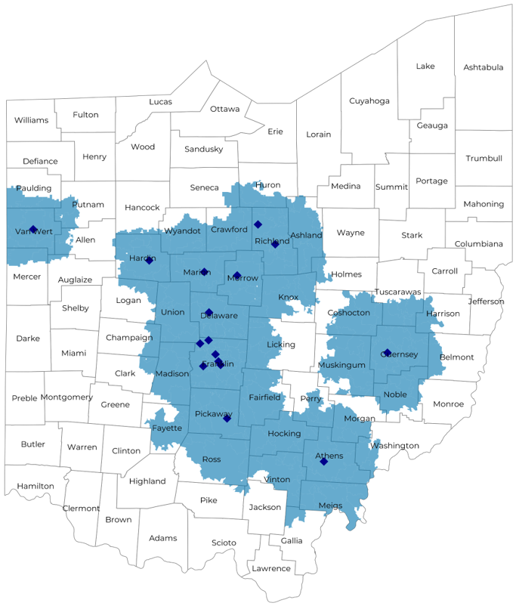
Significant room for plan growth
MARKET OPPORTUNITY
3,500+
800,000+
1,500,000+
Employers
Employees
Members
Commercial employers headquartered in the OhioHealth catchment area, by employer size (number of employees)
 | 50-100 | 101-200 | 201-400 | 401-1,000 | 1,001-3,000 | 3,000+
Employers | 1,995 | 900 | 565 | 300 | 111 | 79
Employees | 149,600 | 135,000 | 169,500 | 210,000 | 222,000 | 474,000
Members | 269,300 | 243,000 | 305,100 | 378,000 | 399,600 | 853,200

Slide 9
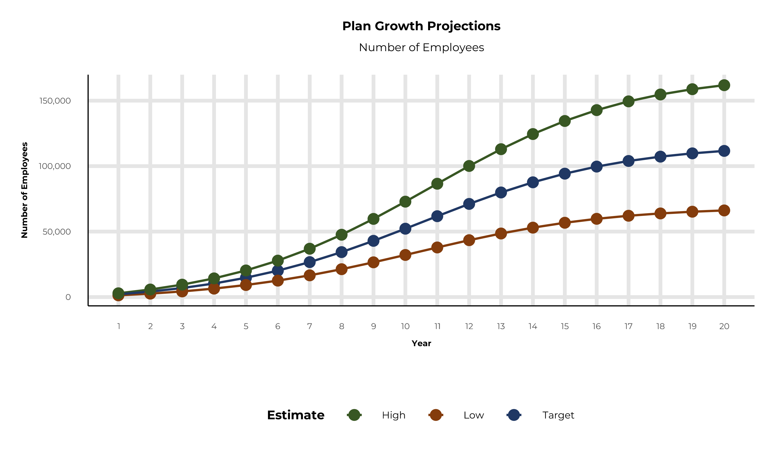
Plan potential growth paths
MARKET OPPORTUNITY
Population
2,585K
Working age
1,546K
Insured
1,091K
Self-funded
765K
Service area includes Allen, Ashland, Athens, Champaign, Coshocton, Crawford, Delaware, Fairfield, Franklin, Guernsey, Hardin, Harrison, Hocking, Huron, Knox, Licking, Madison, Marion, Meigs, Mercer, Morgan, Morrow, Muskingum, Noble, Perry, Pickaway, Richland, Ross, Tuscarawas, Union, Van Wert, Vinton, Washington and Wyandot counties.

Slide 10
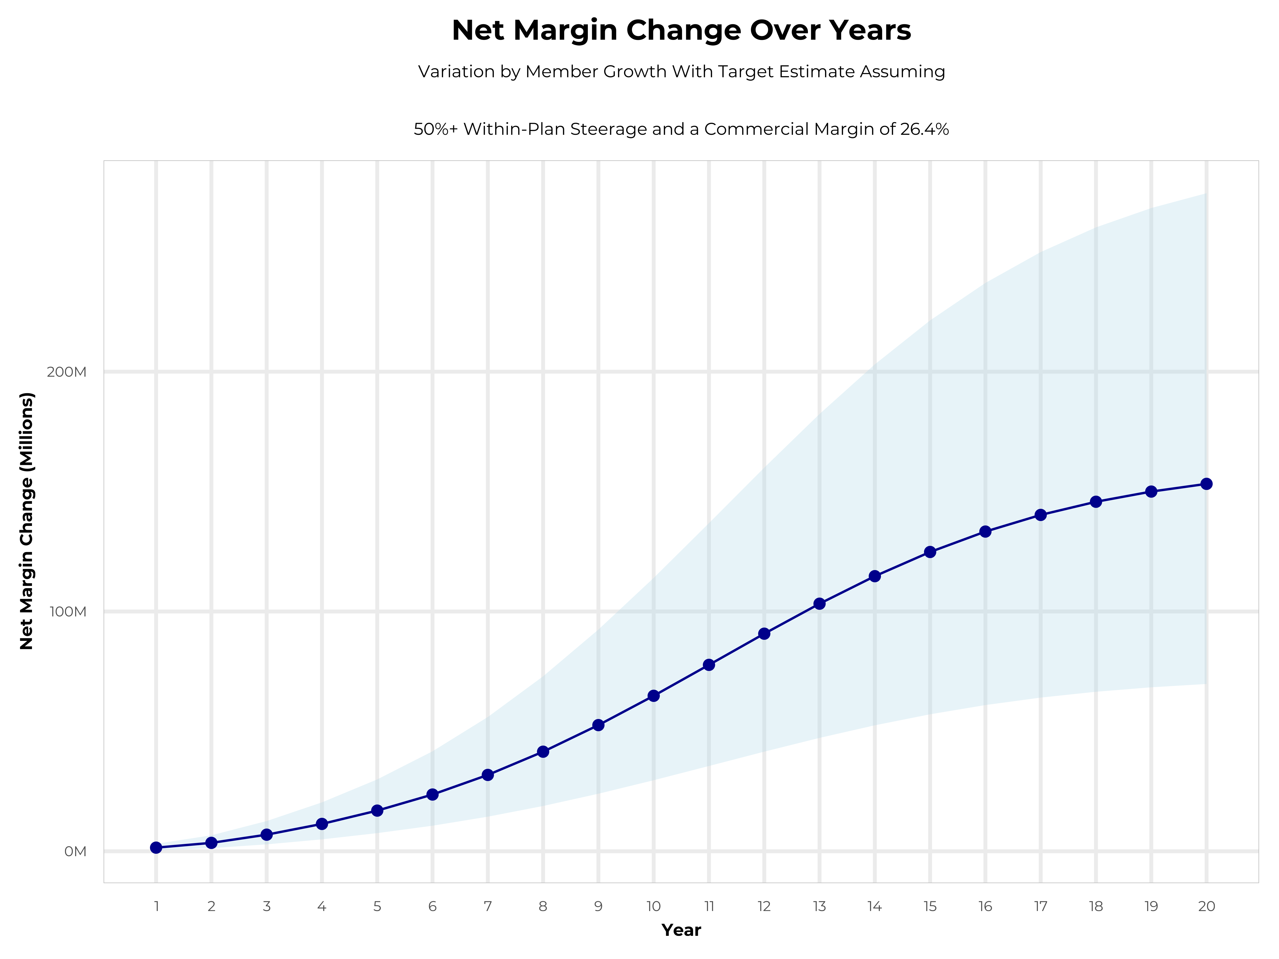
Growing powerful, lasting profitability
LONG-TERM ECONOMICS
Early stage
Gaining name recognition, early growth
New revenue
$40.28M
New profit
$10.66M
Growth stage
Strong reputation, strong growth
New revenue
$246.18M
New profit
$66.08M
Mature stage
High profitability, market saturation
New revenue
$512.03M
New profit
$137.44M

Slide 11
Net margin change grows to $20.6M by Year 4
FOUR-YEAR PROJECTIONS
Target case ($K) | Year 1 | Year 2 | Year 3 | Year 4
Number of Members | 3,800 | 7,500 | 12,400 | 18,600
Incremental Margin | 3,301.4K | 6,518.9K | 12,640.4K | 20,592.0K
Network Access Fee | 45.6K | 90.0K | 148.8K | 223.2K
Implementation Fee (One-Time) | -150.0K | 0.0K | 0.0K | 0.0K
Sales and Marketing Costs | -180.0K | -180.0K | -180.0K | -180.0K
Net Margin Change | 3,017.0K | 6,428.9K | 12,609.2K | 20,635.2K
HIGH CASE, YEAR 4
$28.6M
25,700 members
LOW CASE, YEAR 4
$12.8M
11,600 members

Slide 12

The benefit steers the patient to OhioHealth
WHAT WILL THIS CLAIM COST ME?
Explanation of benefits: heart attack, cardiac surgery
THE CHARGES
Medical bills | $25,000
Out-of-pocket due to provider | $4,500
THE CREDITS
OP radiology / X-ray | $200
OP diagnostic labs | $100
Preferred hospital stay ($500/day, 5 days) | $2,500
Critical illness benefit | $2,000
Health screening benefit | $125
Benefit total | $4,925
Out-of-pocket paid to hospital | ($4,500)
Balance paid to Health Guardian Account | $425
OhioHealth patients can have all out-of-pocket liability reduced to $0

Slide 13

Creating EPO steerage in a PPO network
THE KBA HEALTHCARE CONVENIENCE CARD
The card works only for specific merchant codes, so it rewards care at preferred providers.
1
Use at specific healthcare providers
Designated hospitals, urgent care facilities, physicians and eligible ancillary providers
2
Out-of-pocket expenses qualify
3
0% interest rate
4
Employee sets the repayment schedule
5
Simple to qualify
Answer one simple question

Slide 14
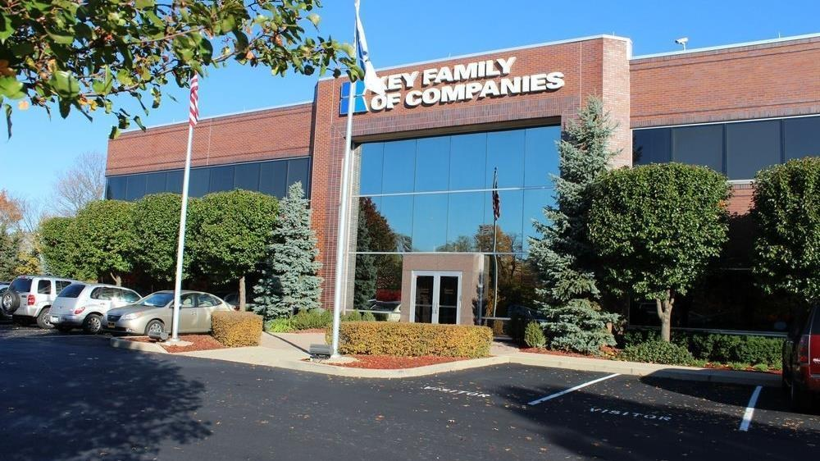



A partner you can trust
Our objectives are aligned
We know the Ohio market
Completely transparent
The sophistication and infrastructure to compete
Derek Moore
Senior Vice President, Key Benefit Administrators
845-283-9973 | derek.moore@keybenefit.com

